Slide 1
In_drive Coupon Recommendation
Data analysis and predictive model project
Manindra singh

Slide 2
Exploratory Data analysis
Feature | Unique value
destination | 3
passanger | 4
weather | 3
temperature | 3
coupon | 5
expiration | 2
gender | 2
age | 8
maritalStatus | 5
has_children | 2
education | 6
occupation | 25
income | 9
car | 5
Bar | 5
CoffeeHouse | 5
CarryAway | 5
RestaurantLessThan20 | 5
Restaurant20To50 | 5
toCoupon_GEQ5min | 1
toCoupon_GEQ15min | 2
toCoupon_GEQ25min | 2
direction_same | 2
direction_opp | 2
Accept(Y/N?) | 2
Data Structure – 12684 rows * 25 columns
Duplicated records?
After removing duplicated values:
Data Structure – 12393 rows * 25 Columns
Every feature in the dataset has categorical unique values.
Feature ‘toCoupon_GEQ5min’ has single value.
It will not add value to the model. Removed these feature.

Slide 3
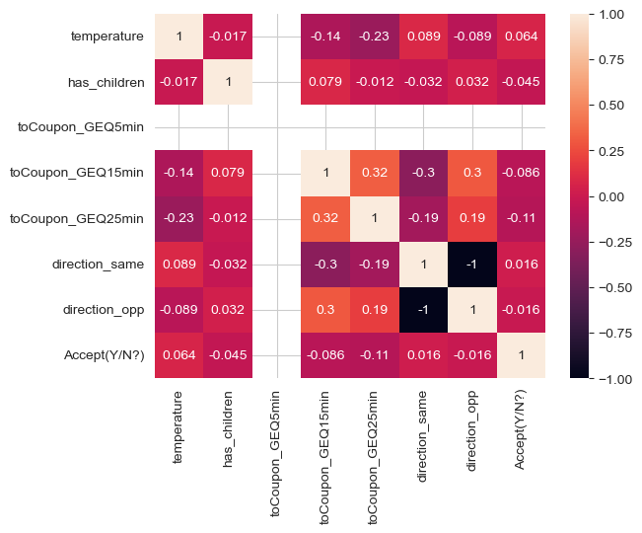
Correlation matrix
Feature ‘direction_same’ and
‘direction_opp’ has perfect
Negative correlation.
Removed ‘direction_opp’.

Slide 4
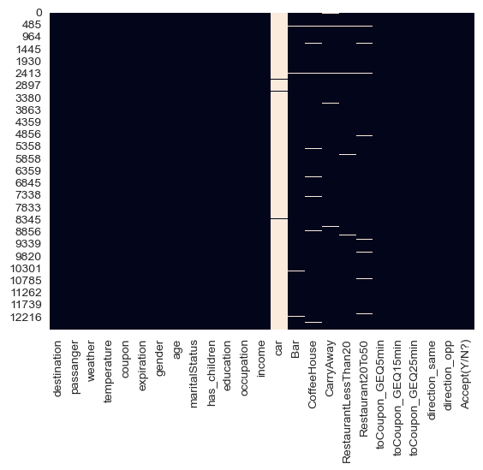
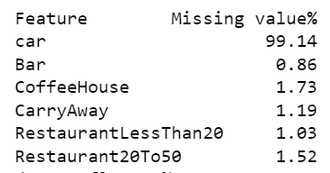
Missing values
Feature ‘car’ has 99% missing values.
Removed this feature.
Missing values heatmap

Slide 5
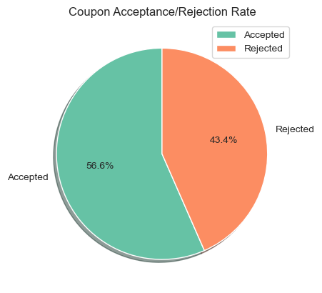
Coupon acceptance rate
Out of 12393 coupons, 56.6% accepted.
Acceptance Rate is higher than rejection rate.
This is our Target variable.
Binary class [yes, no]
So this is a classification problem.

Slide 6
Univariate analysis w.r.t. acceptance rate

Slide 7
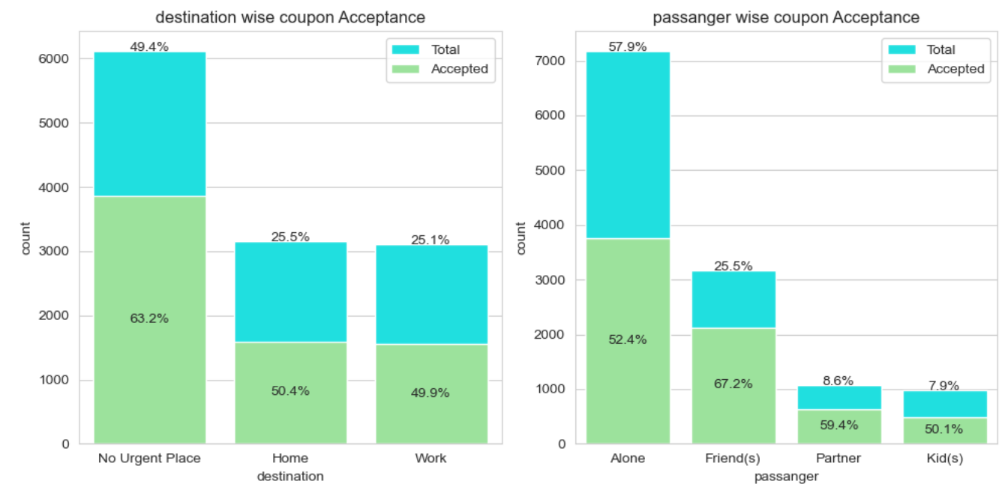
Destination and passanger feature
Majority of people travelling to no urgent place.
user with destination no urgent place have high coupon acceptance rate.
Most of the time user travelling alone.
when user travelling with friends, they have high acceptance rate.
user who go out with kids has lowest acceptance rate.

Slide 8
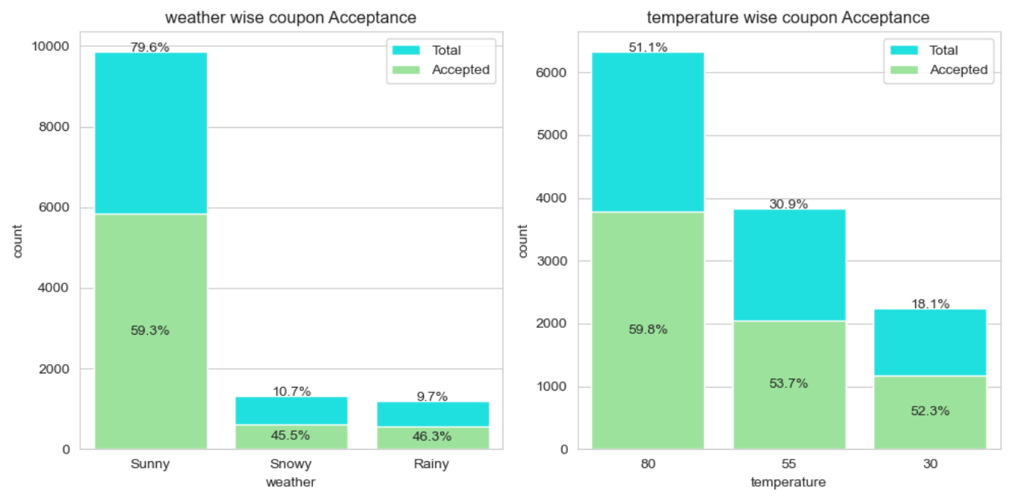
Weather and temperature feature
most of the user travelling on Sunny weather and have high coupon acceptance rate 59.3%.
most of the time users go out when the temperature is 80 F and accepts most of the coupon.
people are less travelling on rainy day and cold days.

Slide 9
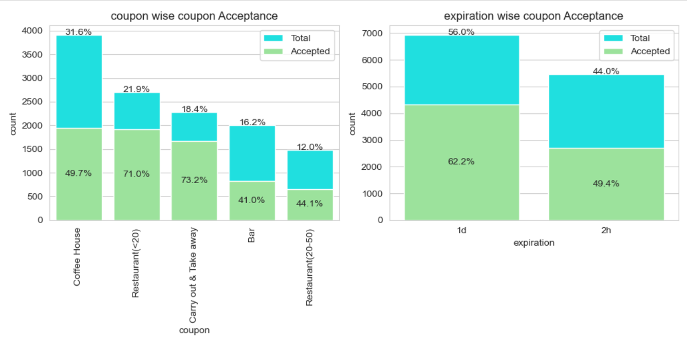
Coupon Type and Expiration feature
people are getting high number of coffee house coupons but their acceptance rate is average.
Take away and Restaurant<20 type of coupons have the highest acceptance rate.
Bar related coupons have least acceptance rate.
people are more accepting coupons with 1day expiry.

Slide 10
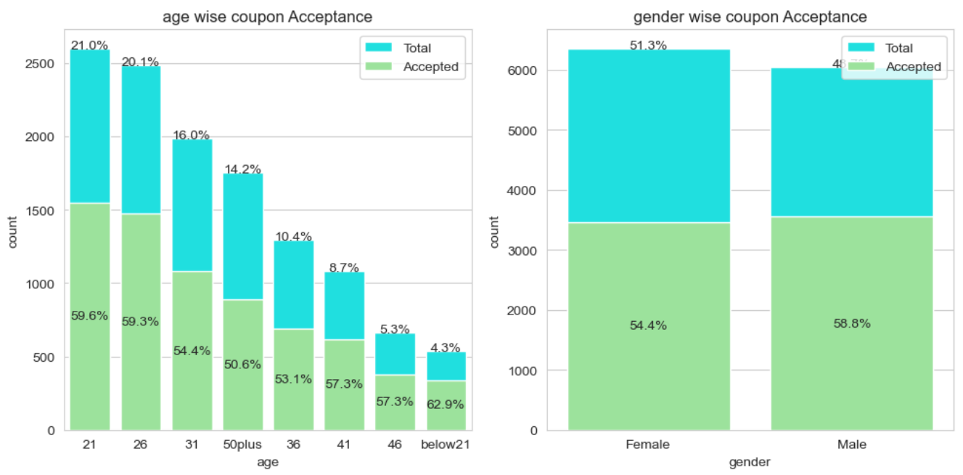
Age and gender feature
56% of the travelers are in 21 to 31 age group.
user with age below 21 have high coupon acceptance ratio.
people of age above 50 have 50% chances of accepting a coupon.
Male travelers have slightly higher chances of accepting a coupon than female traveler.

Slide 11
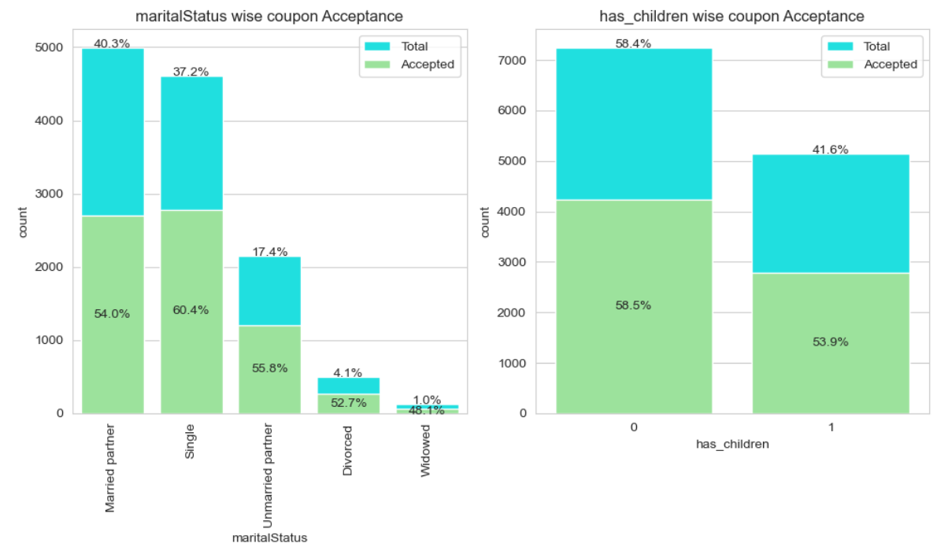
Martial Status and has children feature
most users are single or married.
Single user have high acceptance ratio.
most users dont have children and have high acceptance ratio.

Slide 12
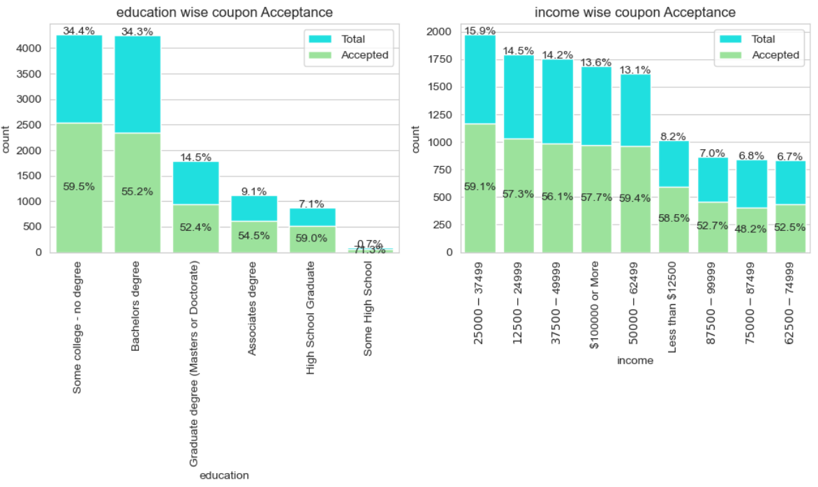
education and income feature
most user have Bachelors Degree or Some college -No degree.
very few user have some high school education but they have highest acceptance ratio.
45% users income is in between 25000-49999.
people with low income or high income accepts more coupons.

Slide 13
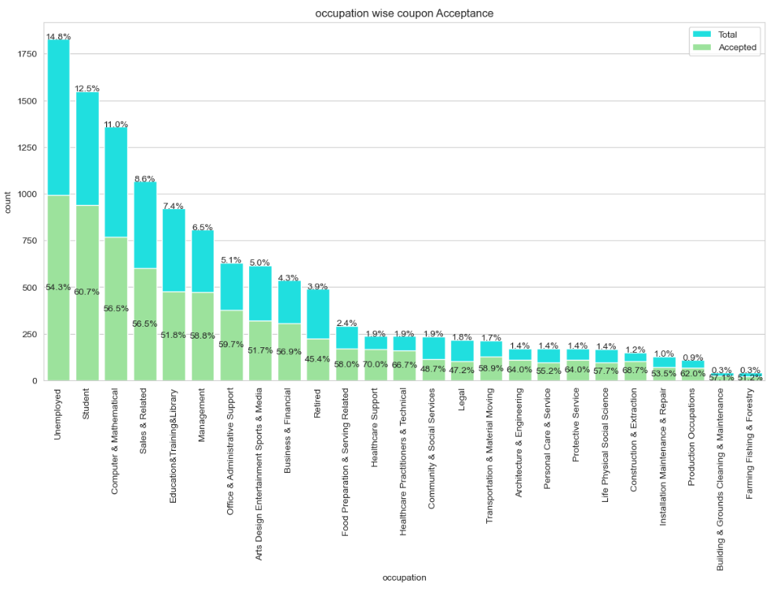
Occupation feature
most users in this data are students or unemployed.
students have high acceptance ration than unemployed person.
suer who works in Healthcare support and construction & extraction have highest acceptance ratio.
retired user have least acceptance ratio.

Slide 14
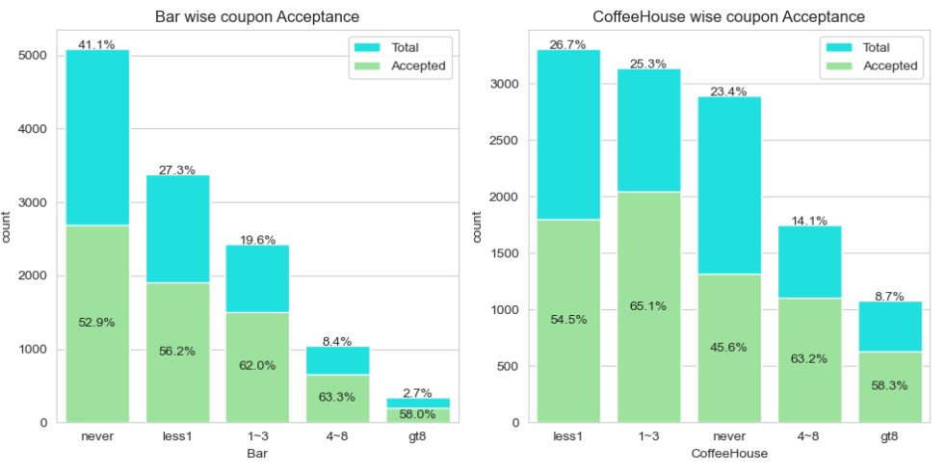
Bar and Coffee house feature
most users in this data have never visited Bar and have less chance of accepting a coupon.
very few user visits bar more than 8 time in a month.
most user in this data visits coffee house less than 1 time a month on average.
people who never visited coffee house have least acceptance ratio.

Slide 15
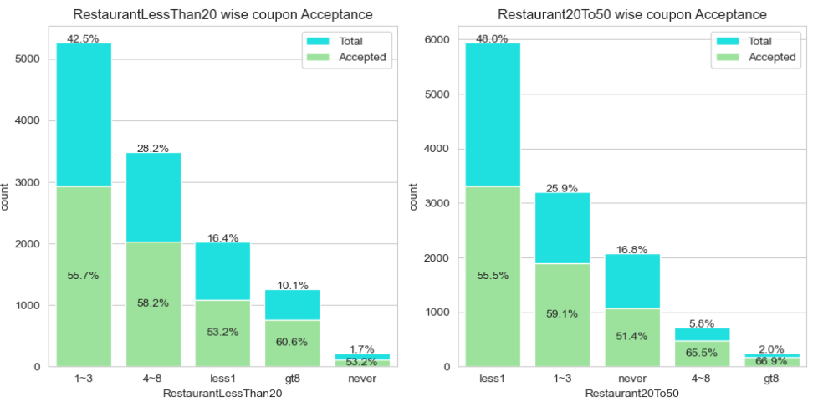
Restaurant <20 and restaurant 20to50 feature
most users, visits ReastaurantLessThan20 1-3 time in a month on average.
very few users have never visited ReastaurantLessThan20.
people who visits ReastaurantLessThan20 more than 9 times in month have high acceptance rate.
most user in this data visits Reastaurant20to50 less than 1 time a month on avergae.

Slide 16
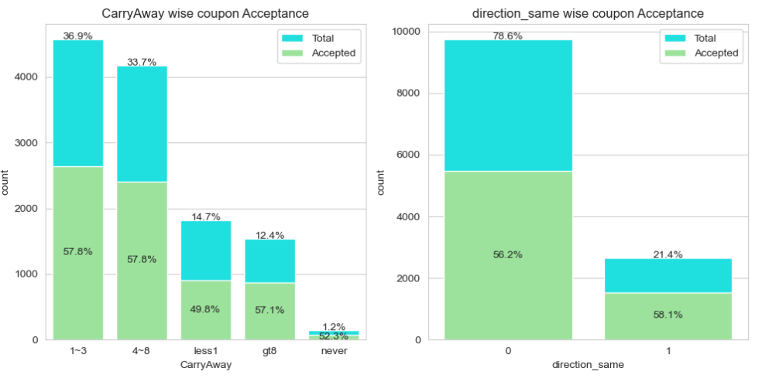
Carry away and direction_same feature
most of travelers visited 1-3 times Carrayaway in a month.
very few users never visits carrayaway.
78% traveler are travelling in opposite direction.
coupon acceptance ratio is almost same irrespective of direction. direction has no effect on coupon acceptance.

Slide 17
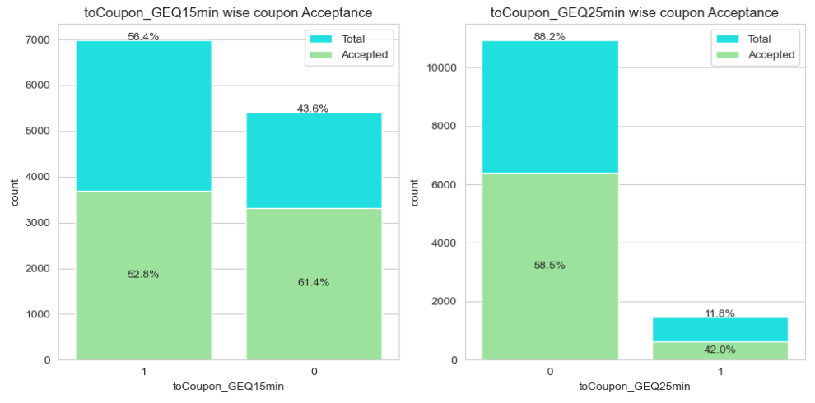
Tocoupon_geq15min and Tocoupon_geq25min feature
56% coupons outlet is more than 15min distance from traveler.
if coupon outlet is within 15min from traveler, chances of accepting are higher.
88% coupons offers have a outlet within 25min distance from traveler.
if coupon outlet is within 25min distance, we have high chances that traveler will accept the coupon.

Slide 18
Bivariate analysis

Slide 19
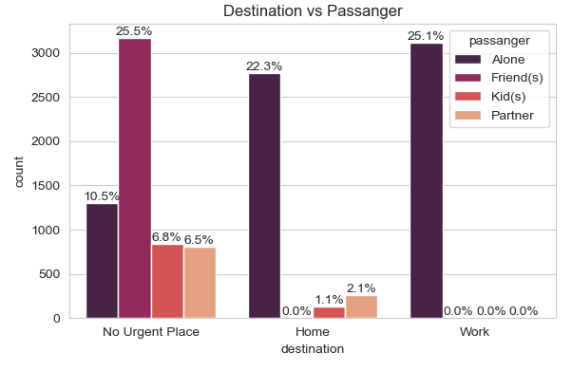
Destination vs passanger
most of the user are travelling Alone either to work or home.
25% travelers are going out with friend to no urgent place.
with friend, user only go to no urgent place.
very less travelers are travelling with kids.

Slide 20
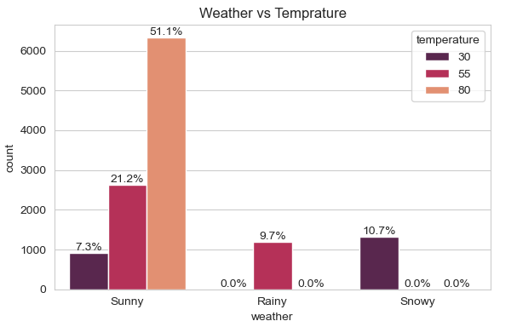
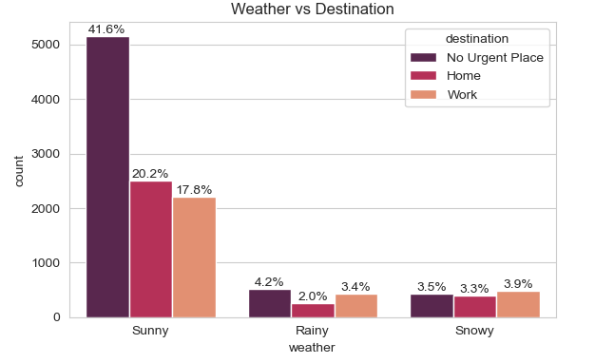
Weather vs temperature
Weather vs Destination
traveler prefer sunny weather for traveling.
on Snowy or rainy weather temperature is less than 80F.
40% travelers are travelling to no urgent place on sunny weather.
on rainy or snowy weathers very less people traveling to no urgent place.

Slide 21
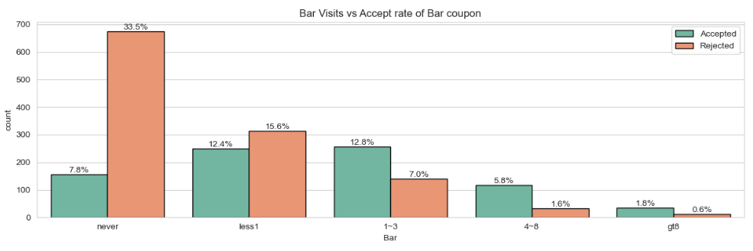
BAr vs accept rate of bar coupon
user who never visited bar or less than 1 have high rejection aratio.
people who are more frequent to bar have high acceptance ratio.
bar coupon acceptance ratio is increasing as visits are increasing.

Slide 22
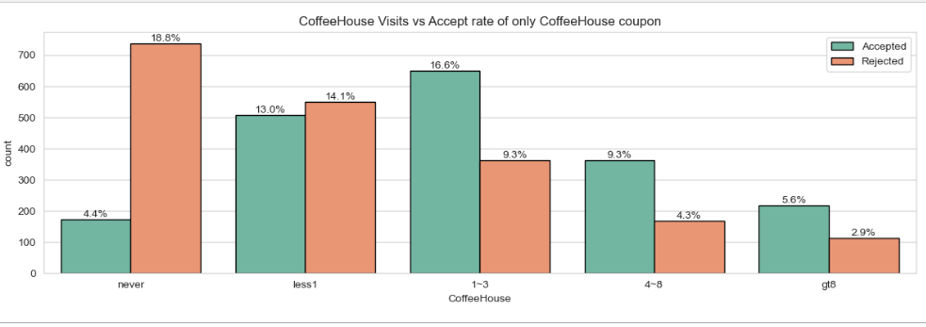
Coffee house vs accept rate of coffee house coupon
user who never visited Coffee House or less than 1 have high rejection ratio.
people who are more frequent to Coffee house have high acceptance ratio.
Coffee House coupon acceptance ratio is increasing as visits are increasing.

Slide 23
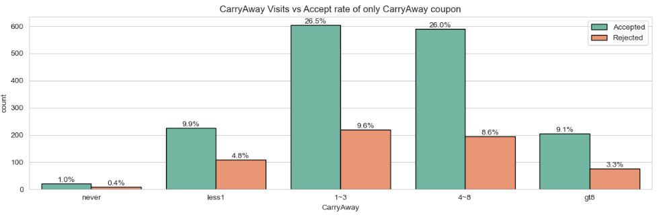
Carry away vs accept rate of carry away coupon
Carry Away coupon have high acceptance ratio irrespective of visits.
user who have visit frequency 1-3 and 4-8 have high acceptance raio.

Slide 24
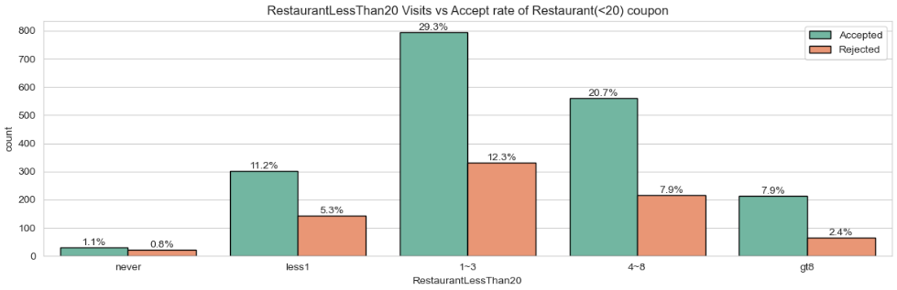
Restaurant <20 vs accept rate of restaurant <20 coupon
RestaurantLessThan20 coupon acceptance ratio is increasing with respect to no. of visits.
user who have visit frequency greater than 8 have high acceptance raio.
user who have never visited have least acceptance ratio (50%).

Slide 25
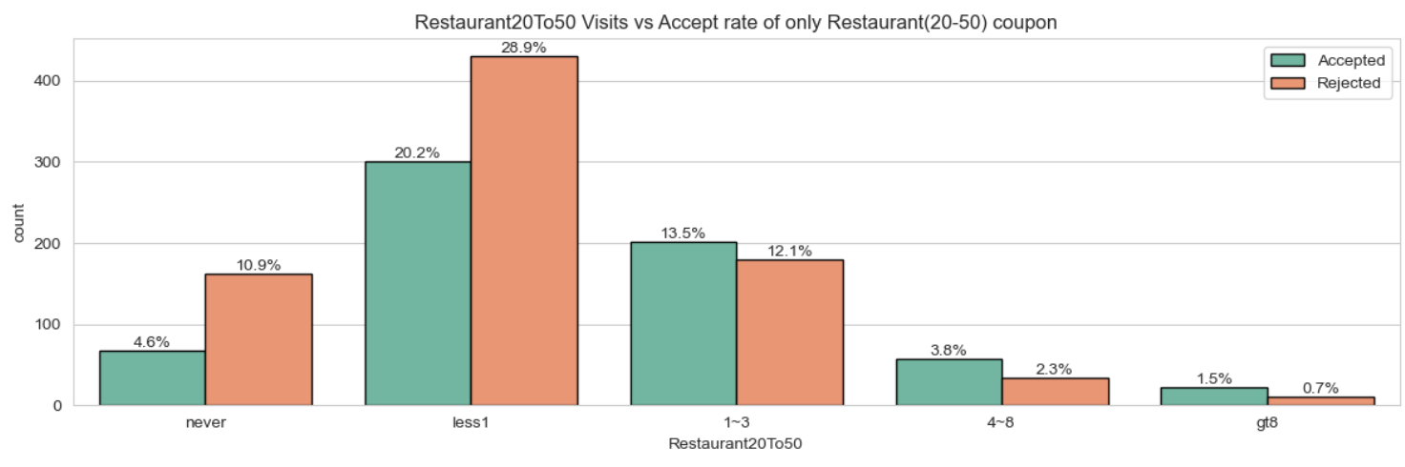
Restaurant 20to50 vs accept rate of restaurant 20to50 coupon
Restaurant20to50 coupon acceptance ratio is increasing with respect to no. of visits.
user who have visit frequency greater than 8 have high acceptance raio.
user who have never visited have highest rejection ratio.

Slide 26
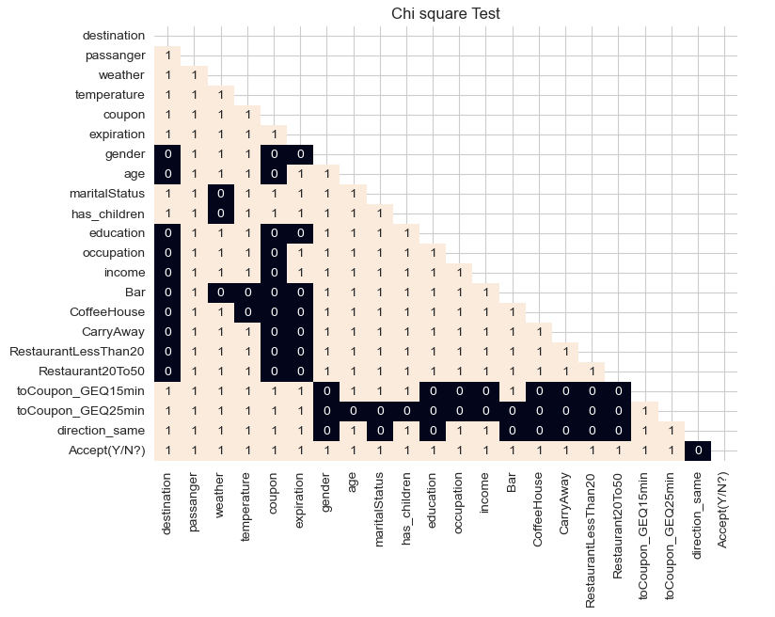
Chi – square test
Feature ‘direction_same’ has no relation with target variable.
Removed this variable

Slide 27
Data pre-processing
Missing values: Imputated with mode.
Feature Engineering
Grouped 25 categories in ‘occupation’ feature to 6 category
Created new feature ‘tocoupon’ from 'toCoupon_GEQ15min' and 'toCoupon_GEQ25min’ features
Created new feature ‘CouponType_freq’ from RestaurantLessThan20, CoffeeHouse, CarryAway, Bar, Restaurant20To50 features
New feature ‘weatherTemp’ from ‘weather’ and ‘temperature’ features
Enconding: Label for ordinal category, One hot for nominal category
Feature scaling

Slide 28
Predictive modelling

Slide 29
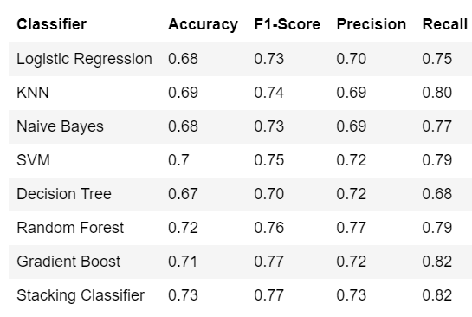
Machine learning algorithm
Build 8 different machine learning models to predict.
By comparing different metrics, its clear that random forest model is performing best.

Slide 30
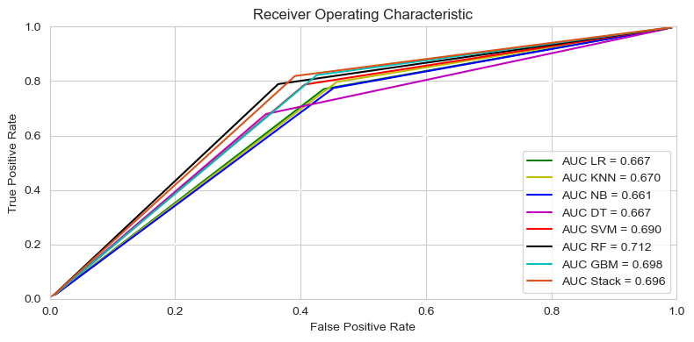
ROC auc curve
ROC Curve - ROC curve is a model selection metric for class classification problems.
Random Forest model have highest area under Curve.

Slide 31
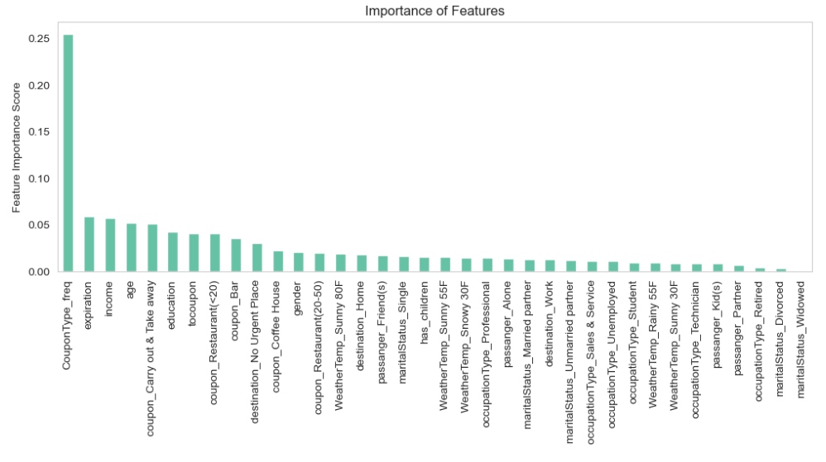
Feature importance
Feature ‘CouponType_freq’ has highest score.

Slide 32
Key analysis
Prioritize giving coupons based on high frequent visits.
Give 1day expiry coupon instead of 2hour.
Carry Away and Restaurant <20 coupon has highest acceptance ration, increase these coupons.
Give Bar, Coffee House and Restaurant 20to50 coupon to those people who are visit more than 4 time on average in a month.

Slide 33
COnclusion
In this project, we used ‘In Drive Coupon’ dataset to analyze and build models that can classify website visitor, and predict which of them is likely going to make a purchase on the website. 8 different classifiers were built, and the best classification performance is by Random Forest model, followed by Stacking Classifier.
The best classification performance after hyperparameter tuning: Accuracy: 72% F1 Score: 0.77

Slide 34
Thank you

